Slide 1
FINAL PROJECT REPORT
Predictive Maintenance for
Metro Climate & Air Systems
What 1.5 million sensor readings revealed about how a metro air compressor fails.
Joseph (Neil) Truskolaski
Project: 21 June to 15 August 2027 · Data: Porto Metro APU, Feb to Sep 2020
0.580
98.5%
4 / 4
0.97 ms
final F1
recall
faults detected
end-to-end per window

Slide 2
The Project in One Slide
OVERVIEW
Eight weeks, 21 June to 15 August 2027. Two course corrections, both forced by the data.
PROPOSE · 21 JUN
CHECKPOINT · 18 JUL
FINAL · 15 AUG
Cycle-level anomaly detection.
Baseline named: F1 0.32.
→
Cycle unit failed. Moved to
15-min windows. IF lost to physics.
→
Two-layer system shipped.
Early warning fell back to CUSUM.
The final system: Layer 1 detects a fault in progress using an Isolation Forest gated by cluster membership. Layer 2 issues an advisory early warning using a CUSUM change-point detector on cycle rate. The two layers exist because they solve genuinely different problems, and only one of them is solved well.
1,516,948
16,773
16.25 s
2 of 4
readings processed
modelling windows
full clean, end to end
faults warned in advance
Note on the 0.32: it was measured per-sample on the raw stream, not per-window after cleaning. The like-for-like comparator is 0.577, so the real gain in F1 is 0.003, not 0.26. See slide 5.

Slide 3
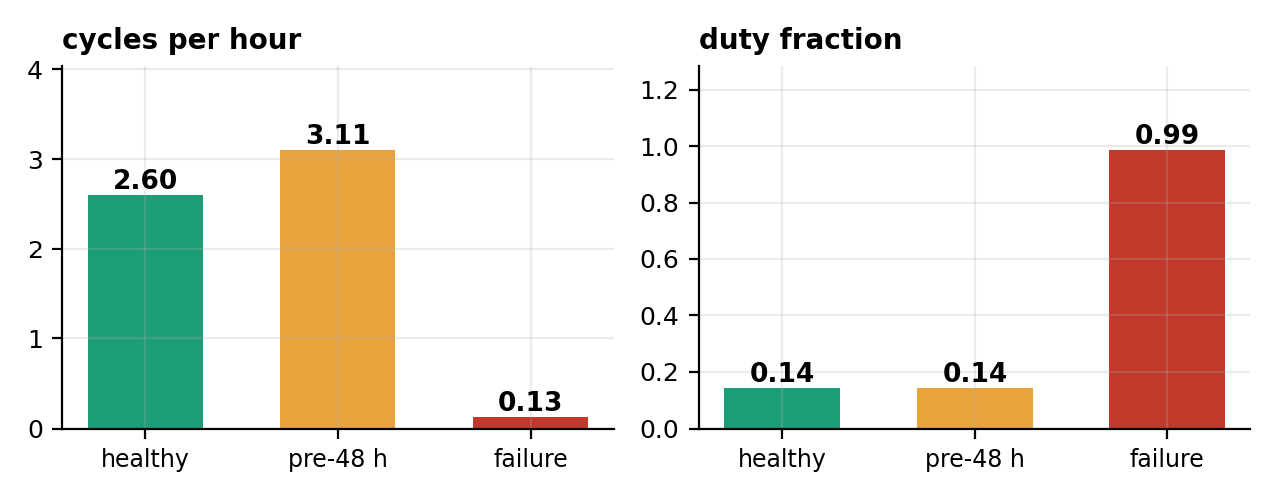
How This Machine Actually Fails
FINDING 1
A three-stage signature, found in the data, not assumed from theory.
HEALTHY
DEVELOPING LEAK
FAILURE
2.60 cycles/h
3.11 cycles/h (+20%)
0.13 cycles/h (-95%)
long, infrequent refills
reservoir drains faster,
so it refills more often
leak outpaces capacity,
cycling stops entirely
Duty cycle sits flat at 0.14 until the moment of failure. Any duty-based alarm therefore has ZERO lead time by construction.

Slide 4
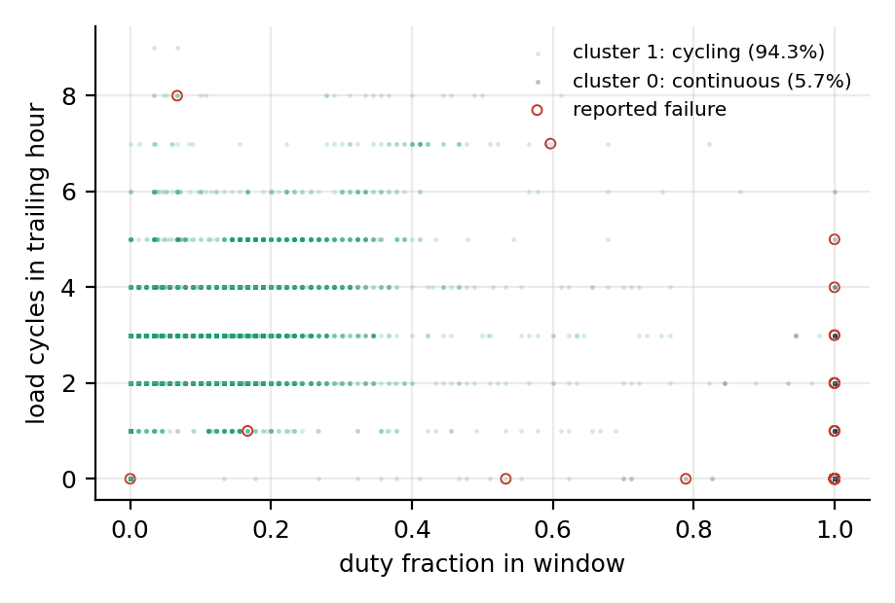
Two Operating Regimes, Found Without Labels
FINDING 2
k = 2, silhouette 0.676. The fault regime emerged unsupervised.
Cluster 1 · cycling
94.3% of windows · 2.6 cycles/h, duty 0.11
0.03% are reported faults
Cluster 0 · continuous run
5.7% of windows · 0.004 cycles/h, duty 1.00
34.0% are reported faults
98.5% of faults are in cluster 0
But two thirds of cluster 0 has no maintenance report. Continuous running is necessary, not sufficient.
This is the ceiling on precision, and it is set by the labels rather than by any model.

Slide 5
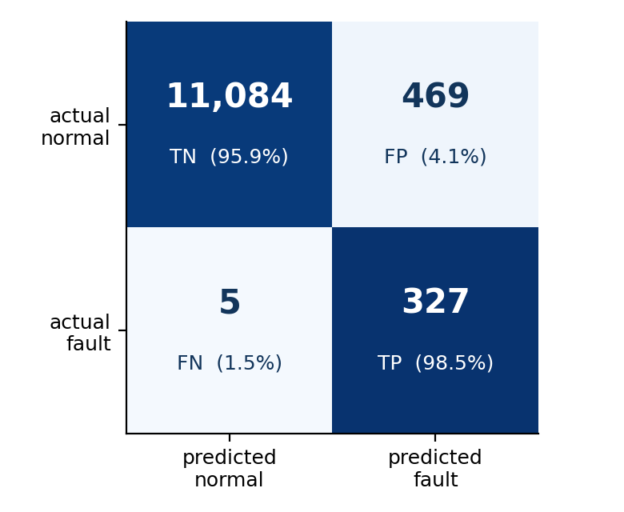
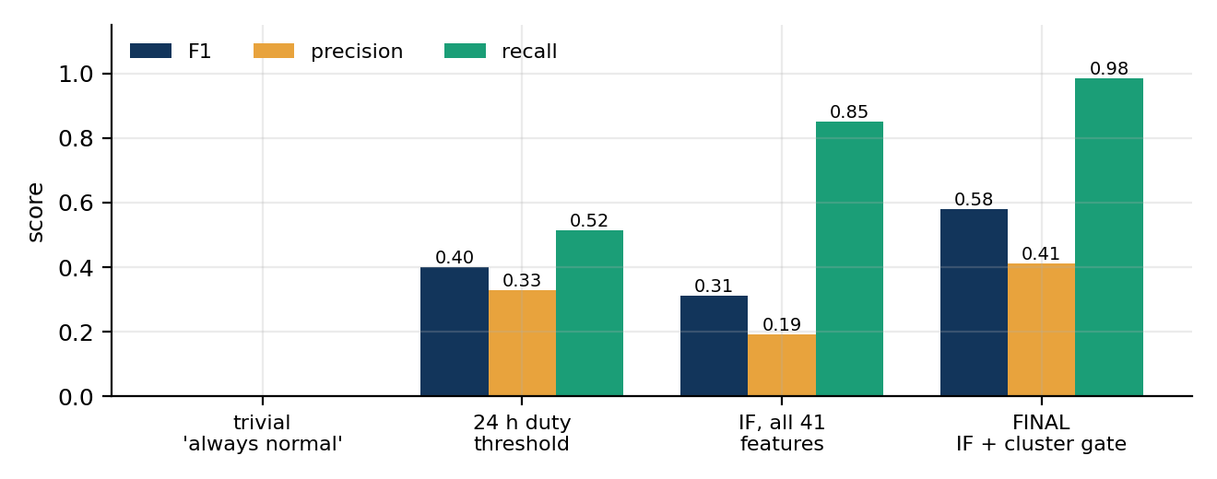
Detection Performance
RESULTS
Test period April to September. 11,885 windows, 332 of them faults.
Why accuracy is the wrong headline
Our model scores 96.0% accuracy. A model that predicts 'normal' every single time scores 97.2%. Accuracy rewards ignoring the faults entirely, which is why every number we report is precision, recall or PR-AUC.
0.580
0.411
0.985
92 / 30d
F1
precision
recall
false alarms
Like for like: the best physical threshold reaches F1 0.577, so our gain is 0.003, not the 0.26 implied by the proposal's 0.32 baseline. At EQUAL alert budget the margin is 0.088, because duty saturates (798 tied windows) and cannot be dialled to a budget at all. The model buys controllability, not accuracy.

Slide 6
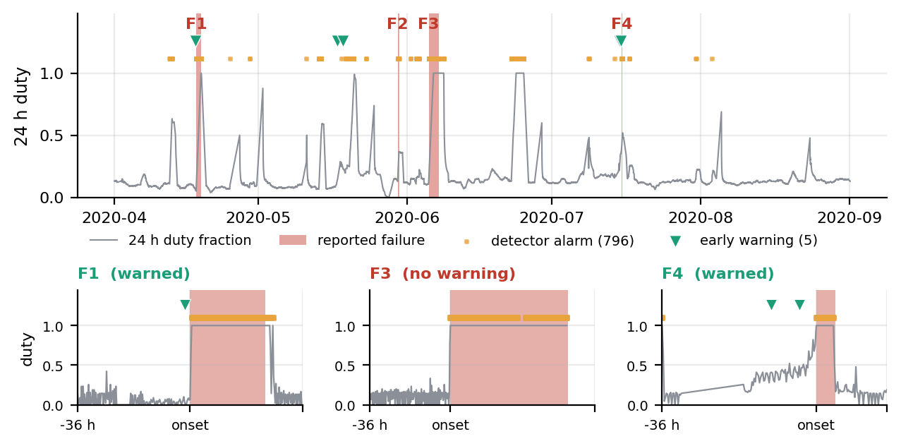
The System Running Across Five Months
EVIDENCE
Every fault caught. Early warning on two of four. Insets zoom three events.
4 / 4
2 / 4
10.5 h
0.4 / 30d
faults detected while in progress
faults warned before onset
longest advance warning
early-warning false alarms

Slide 7
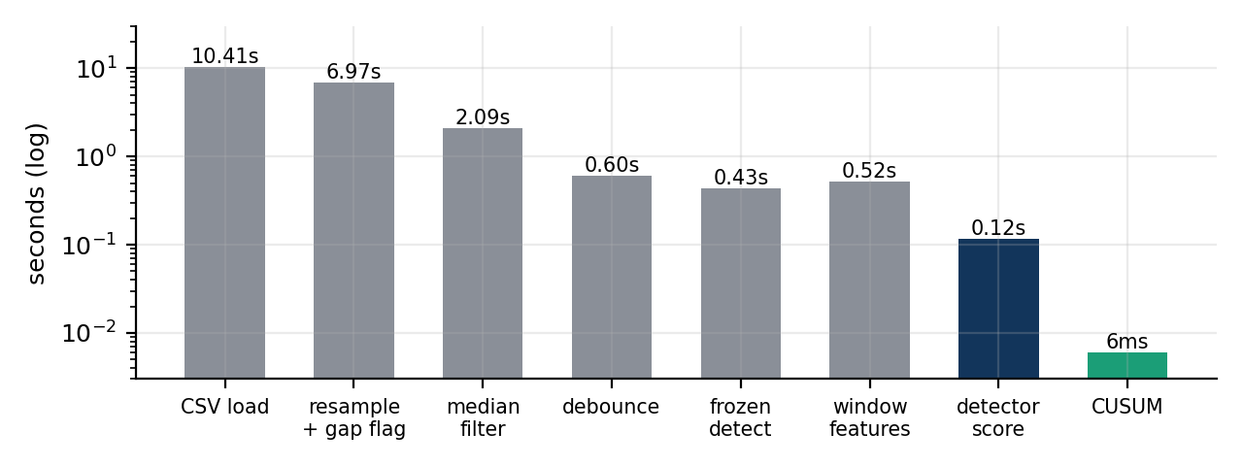
Feasible at Scale
EFFICIENCY
The deployment question is settled, and not narrowly.
Headroom
0.97 ms
END TO END per window, including all pre-processing, against a 15-minute window period.
About 10^6 times faster than real time. Scoring alone is 0.008 ms, but that is only the cheapest stage.
97,190
readings/s cleaning throughput
15.6 s
to clean all 1.5M readings
7.18 s
resampling and gap flagging, the real bottleneck
2.2 s
18 weekly drift refits, total
We quote the end-to-end figure because it describes the deployed system, and 10^6 already settles the question.

Slide 8
What Worked, What Did Not
REFLECTION
Three methods failed. Two of the three taught us something; the third we still cannot fully explain.
Worked
Did not work
✓ Clustering
✗ Cycle as the modelling unit
0.07 s to fit, recovered the fault regime with no labels. Best value per hour spent in the project.
Only 3 of 10,974 cycles fall inside a fault, because failure stops the cycling. Demoted to a feature source.
✓ Physics-scoped features
✗ Isolation Forest on all features
Cutting 41 features to 14 raised F1 from 0.31 to 0.55. Domain reasoning beat capacity.
F1 0.31, worse than a one-line threshold. Cause: seasonal drift plus feature dilution.
✓ Flagging gaps, not filling them
✗ Engineered precursor features
909 hours of missing record never became fabricated training data.
Ten drift-robust features made lead-time prediction slightly worse. At four events we cannot say why.
The switch rule fired at the bar, not below it: 3.0x vs 2.7x is inside one fold SD, so we resolved the tie conservatively and shipped the fallback. Six planned analyses were also cut, SHAP attribution first; report section 7.4 lists all of them.

Slide 9
Where This Goes Next
NEXT
Four directions, ordered by how much they would change the answer.
1
Instrument cycle timing directly
2
Get more events
The strongest early signal is cycle frequency, which we recovered indirectly from a 10 s digital flag. A dedicated cycle-event log at source would sharpen it substantially, and costs almost nothing to add.
Every supervised limit here is a four-event limit, not a method limit. Pooling MetroPT-1 and MetroPT-2, which cover other vehicles and oil-leak faults, is the highest-value next step.
3
Real-time dashboard
4
Transfer to other fleets
At 0.008 ms per window the scorer is free. A streaming deployment showing regime, anomaly score and cycle-rate CUSUM would close the loop to the maintenance desk.
Test whether cycle-frequency features generalise across compressors and transit systems, or whether each unit needs its own baseline.
Note the ordering. Two of the top three are about better data. Eight weeks established that the models were not the constraint.

Slide 10
What We Learned
About the machine, and about doing this kind of work.
About the compressor
About the modelling
Failure has a three-stage signature. Cycling frequency rises 20% before onset and collapses 95% at onset, while duty cycle stays flat until the fault is already present.
A one-line physical threshold beat a 41-feature Isolation Forest. Domain reasoning outperformed model capacity at every stage of this project.
About the data
About the process
Two thirds of the continuous-run regime carries no maintenance report. Precision here is bounded by record-keeping, not by algorithms.
Two planned methods failed and were replaced. Writing the switch rule down before we knew the answer is what kept week 6 from becoming open-ended.
Where this leaves a maintenance planner: a detector that essentially never misses a fault in progress, and an advisory warning that fires hours ahead on half of them. Half the problem, solved.
Joseph (Neil) Truskolaski · MetroPT-3 Final Report
Notes:
End on the partial answer rather than overclaiming. Detection is solved, prediction is half solved, and the report says exactly which half and why.

